Slide 1


Slide 2






‘Brolly’ Framework released
DWP Steering Group on Work & Health Programme
4 London SRPs and GMCA chosen as phase 1 devolution
6 National Lots (NE, NW, CE, S, SEEA, Wales)
JETS & WHP Pioneer add-ons
Pandemic took us a few steps back!

Slide 3

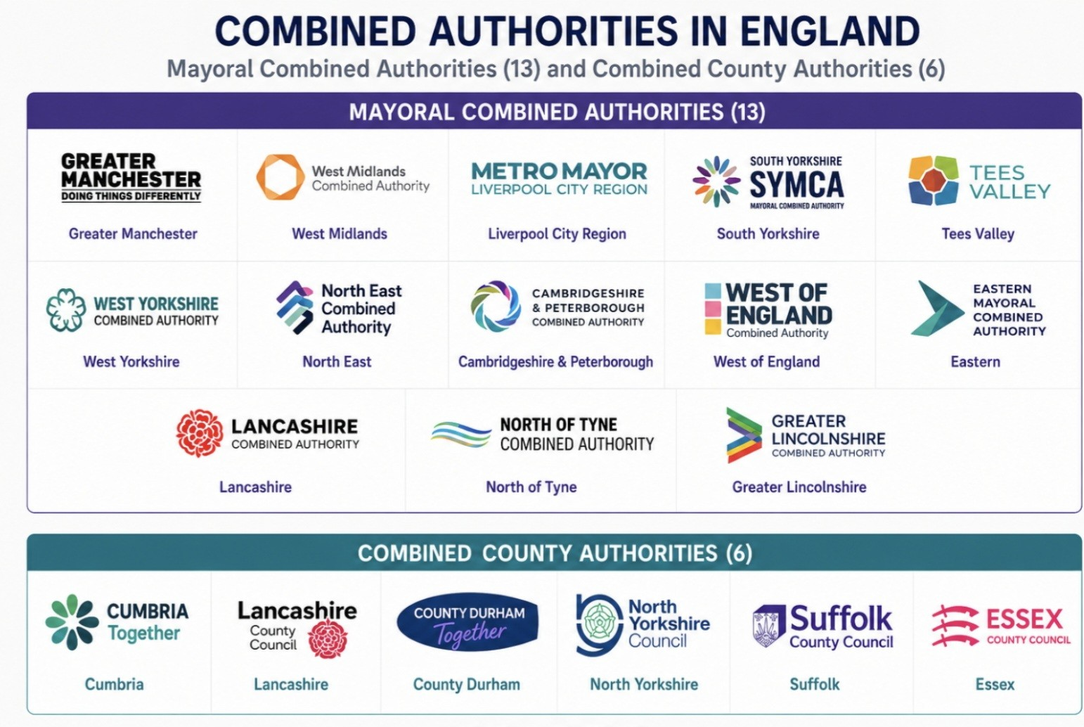

Slide 4
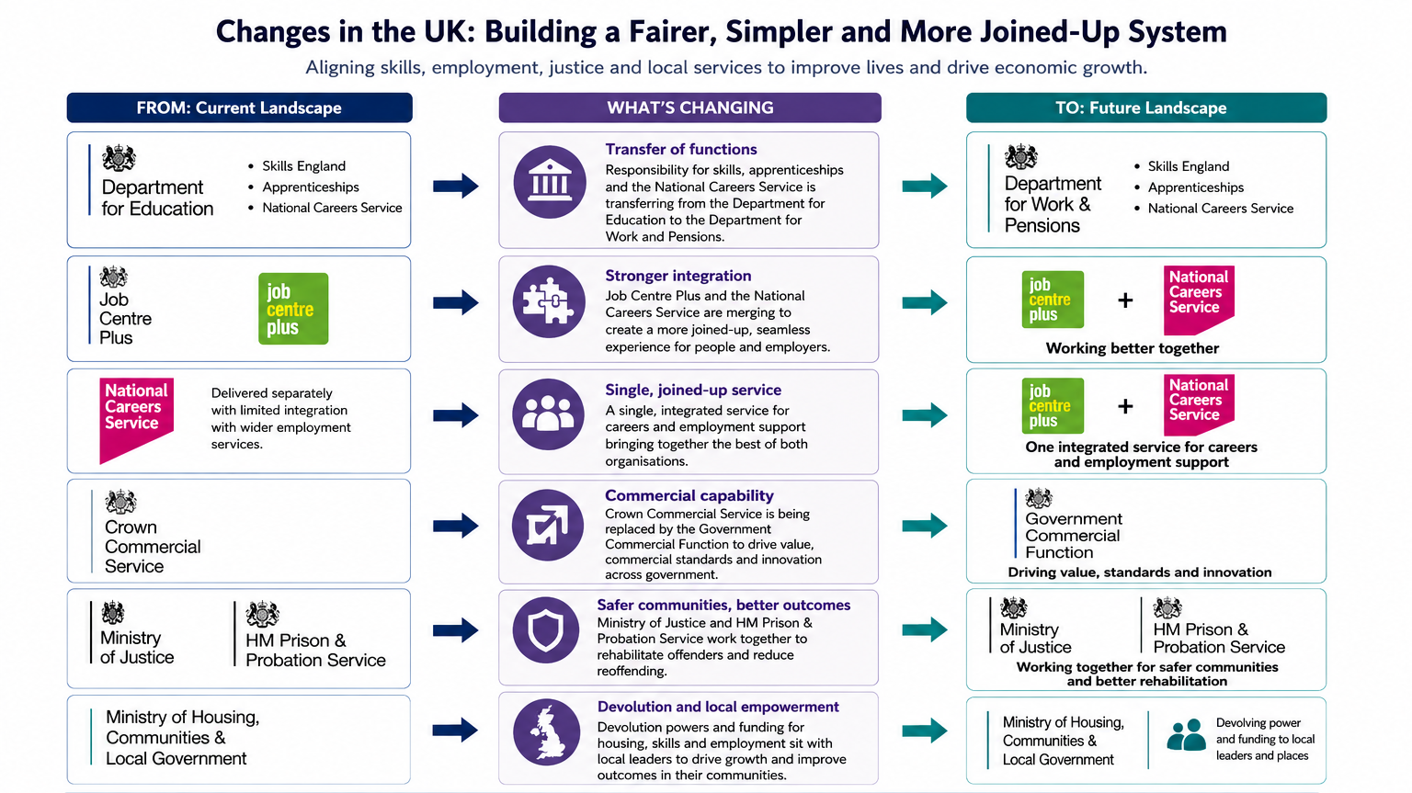

Slide 5

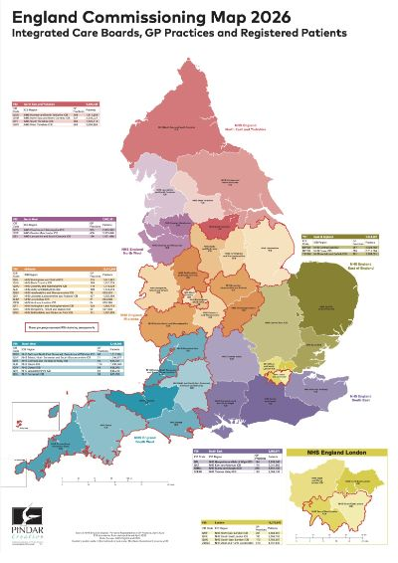


Slide 6
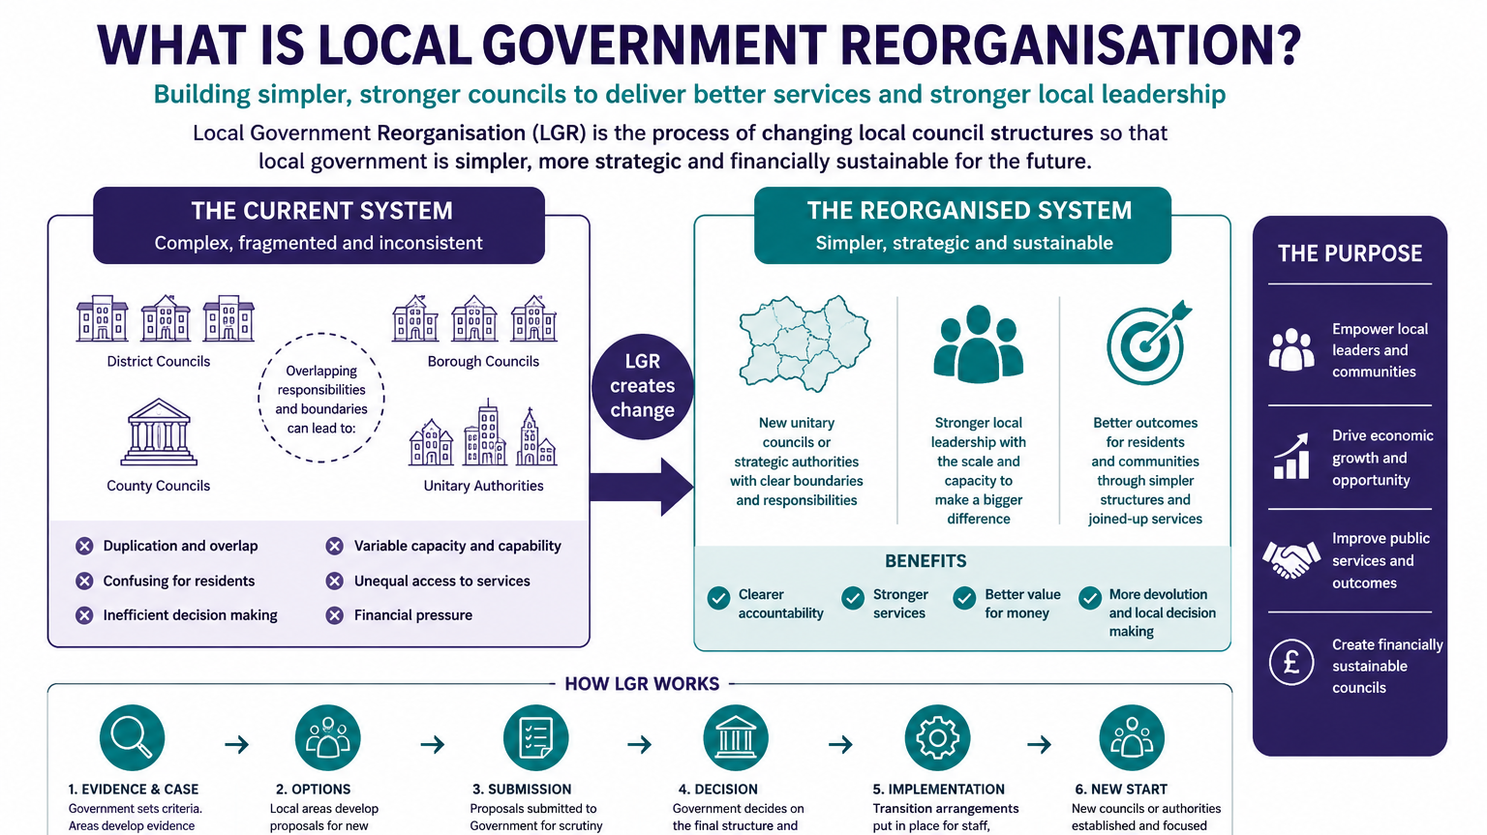

Slide 7
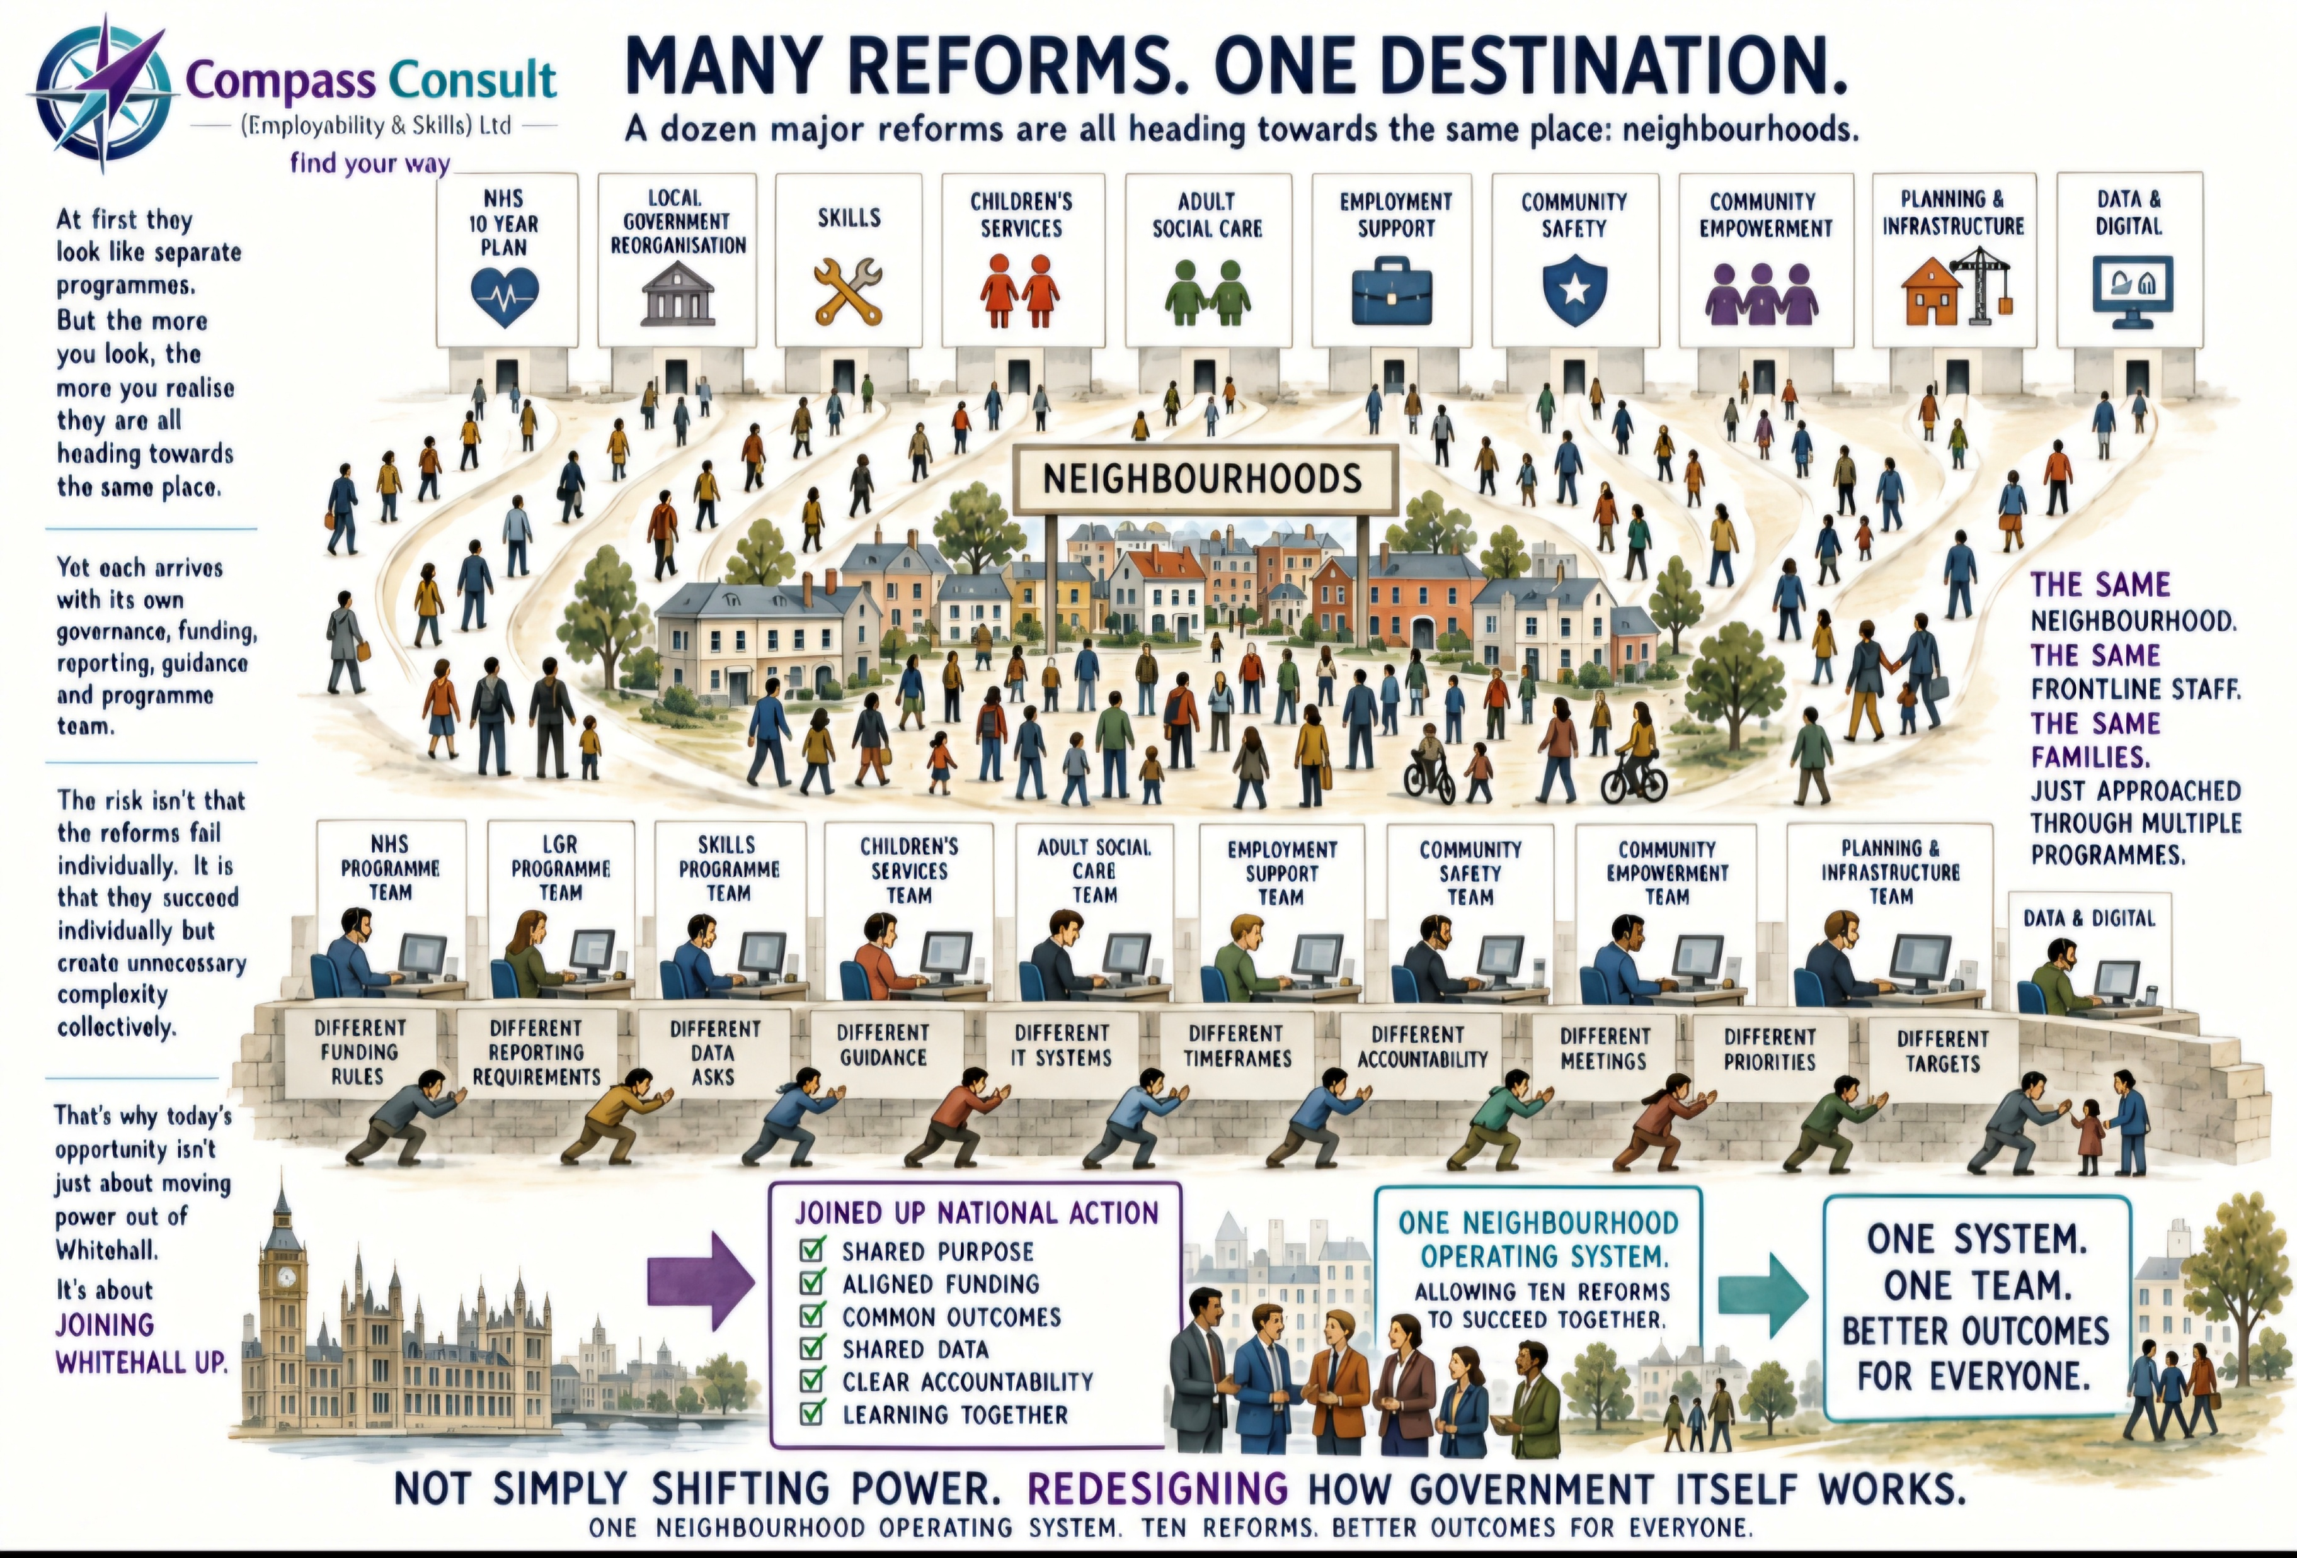

Slide 8
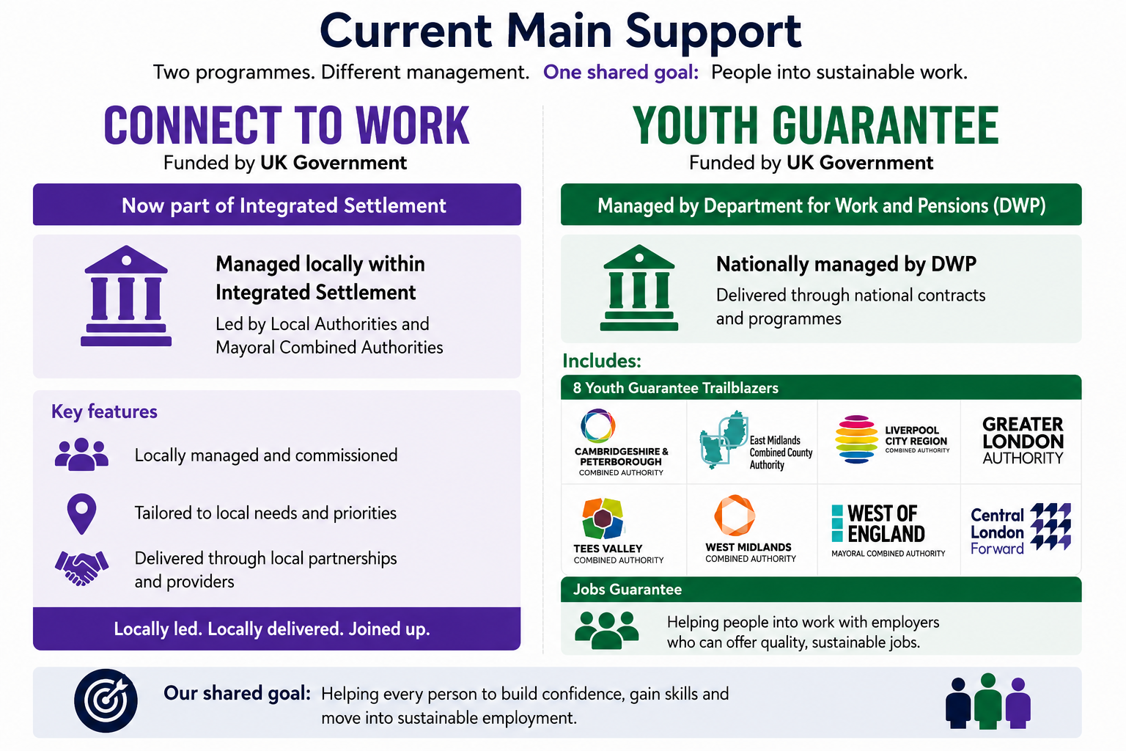

Slide 9


Slide 10


Slide 11


Slide 12


Slide 13


Slide 14




